Slide 1
BASIC JAVA IO
Instructor:

Slide 2
Table of contents
I/O Tutorial
Binary Stream
Character stream

Slide 3
Learning Approach
Strongly suggested for a better learning and understanding of this course:
Noting down the key concepts in the class
Analyze all the examples / code snippets provided
Study and understand the self study topics
Completion and submission of all the assignments, on time
Completion of the self review questions in the lab guide
Study and understand all the artifacts
Completion of the project on time inclusive of individual and group activities
Notes:
The following are strongly suggested for a better learning and understanding of this course:
Noting down the key concepts in the class
Analyze all the examples / code snippets provided
Study and understand the self study topics
Completion and submission of all the assignments, on time
Completion of the self review questions in the lab guide
Study and understand all the artifacts including the reference materials / e-learning / supplementary materials specified
Completion of the project (if application for this course) on time inclusive of individual and group activities
Taking part in the self assessment activities
Participation in the doubt clearing Sections

Slide 4
I/O Tutorial
Section 1

Slide 5
Overview
Java I/O (Input and Output) is used to process the input and produce the output.
Java uses the concept of a stream to make I/O operation fast. The java.io package contains all the classes required for input and output operations.
We can perform file handling in Java by Java I/O API.
Stream:
A stream is a sequence of data. A stream is composed of bytes (It's called a stream because it is like a stream of water that continues to flow).
Three streams are created for us automatically. All these streams are attached with the console.
1) System.out: standard output stream
2) System.in: standard input stream
3) System.err: standard error stream
System.out.println("simple message");
System.err.println("error message");

Slide 6
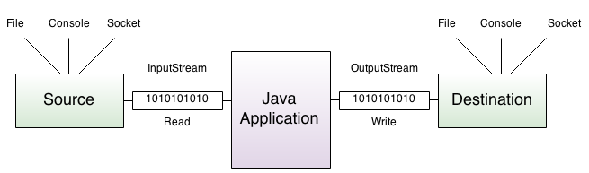
Java Stream
A stream can be defined as a sequence of data. There are two kinds of Streams −
InputStream − The InputStream is used to read data from a source.
OutputStream − The OutputStream is used for writing data to a destination.
Notes:
peripheral device: thiết bị ngoại vi

Slide 7
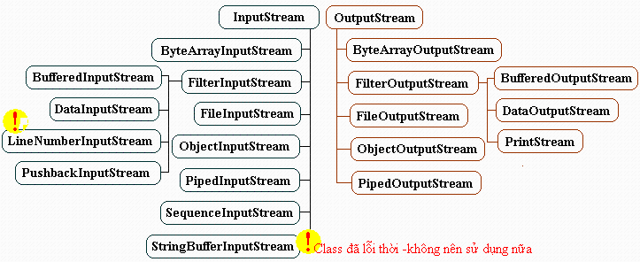
Binary streams
Java byte streams are used to perform input and output of 8-bit bytes.
Though there are many classes related to byte streams but the most frequently used classes are, FileInputStream and FileOutputStream.
Hierarchy class:

Slide 8
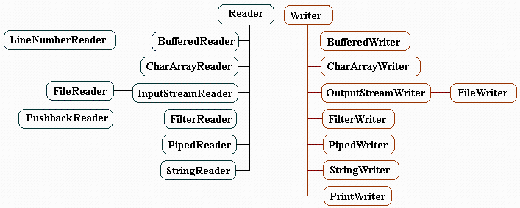
Character streams
Java Byte streams are used to perform input and output of 8-bit bytes, whereas Java Character streams are used to perform input and output for 16-bit unicode.
Hierarchy class:

Slide 9
Binary streams
Section 2

Slide 10
FileInputStream class
FileInputStream class obtains input bytes from a file.
It is used for reading byte-oriented data (streams of raw bytes) such as image data, audio, video etc.
Class Constructors:
No. | Constructor & Description
1 | FileInputStream(File file) This creates a FileInputStream by opening a connection to an actual file, the file named by the File object file in the file system.
2 | FileInputStream(FileDescriptor fdObj) This creates a FileInputStream by using the file descriptor fdObj, which represents an existing connection to an actual file in the file system.
3 | FileInputStream(String name) This creates a FileInputStream by opening a connection to an actual file, the file named by the path name name in the file system.

Slide 11
FileInputStream class
Important methods:
No. | Method & Description
1 | void close() This method closes this file input stream and releases any system resources associated with the stream.
2 | int read() This method reads a byte of data from this input stream. Returns: the next byte of data, or -1 if the end of the file is reached.
3 | int read(byte[] b) This method reads up to b.length bytes of data from this input stream into an array of bytes. Parameters: b - the buffer into which the data is read. Returns: the total number of bytes read into the buffer, or -1.
4 | int read(byte[] b, int off, int len) This method reads up to len bytes of data from this input stream into an array of bytes. Parameters: b - the buffer into which the data is read. off - the start offset in the destination array b len - the maximum number of bytes read. Returns: the total number of bytes read into the buffer, or -1
5 | long skip(long x) It is used to skip over and discards x bytes of data from the input stream.

Slide 12
FileInputStream class
Important methods:
Example:
No. | Method & Description
6 | int available(): This method returns an estimate of the number of remaining bytes that can be read (or skipped over) from this input stream without blocking by the next invocation of a method for this input stream.
public class ReadFile {
public static void main(String args[]) throws IOException {
// attach the file to FileInputStream
FileInputStream fin = new FileInputStream("data.txt");
// illustrating available method
System.out.println("Number of remaining bytes:" + fin.available());
// illustrating skip method
/*Original File content:
* This is my first line
* This is my second line*/
fin.skip(5);
System.out.println("FileContents :");
// read characters from FileInputStream and write them
int ch;
while ((ch = fin.read()) != -1)
System.out.print((char) ch);
// close the file
fin.close();
}
}
Output:
Number of remaining bytes:46
FileContents :
is my first line
This is my second line

Slide 13
FileOutputStream class
FileOutputStream class belongs to byte stream and stores the data in the form of individual bytes.
Class constructor:
No. | Constructor & Description
1 | FileOutputStream(File file) This creates a file output stream to write to the file represented by the specified File object.
2 | FileOutputStream(File file, boolean append) This creates a file output stream to write to the file represented by the specified File object.
3 | FileOutputStream(FileDescriptor fdObj) This creates an output file stream to write to the specified file descriptor, which represents an existing connection to an actual file in the file system.
4 | FileOutputStream(String name) This creates an output file stream to write to the file with the specified name.
5 | FileOutputStream(String name, boolean append) This creates an output file stream to write to the file with the specified name.

Slide 14
FileOutputStream class
Important methods:
void close() : Closes this file output stream and releases any system resources associated with this stream.
protected void finalize() : Cleans up the connection to the file, and ensures that the close method of this file output stream is called when there are no more references to this stream.
void write(byte[] b) : Writes b.length bytes from the specified byte array to this file output stream.
void write(byte[] b, int off, int len) : Writes len bytes from the specified byte array starting at offset off to this file output stream.
void write(int b) : Writes the specified byte to this file output stream.

Slide 15
FileOutputStream class
Examples:
public class WriteFile {
public static void main(String[] args) throws IOException {
//attach keyboard to DataInputStream
DataInputStream dis=new DataInputStream(System.in);
// attach file to FileOutputStream
FileOutputStream fout=new FileOutputStream("file.txt");
//attach FileOutputStream to BufferedOutputStream
BufferedOutputStream bout=new BufferedOutputStream(fout,1024);
System.out.println("Enter text (@ at the end):");
char ch;
//read characters from dis into ch. Then write them into bout.
//repeat this as long as the read character is not @
while((ch=(char)dis.read())!='@') {
bout.write(ch);
}
//close the file
bout.close();
}
}

Slide 16
BufferedOutputStream Class
BufferedOutputStream class is used for buffering an output stream.
It internally uses buffer to store data.
It adds more efficiency than to write data directly into a stream.
So, it makes the performance fast.
Constructors:
Constructor | Description
BufferedOutputStream(OutputStream os) | It creates the new buffered output stream which is used for writing the data to the specified output stream.
BufferedOutputStream(OutputStream os, int size) | It creates the new buffered output stream which is used for writing the data to the specified output stream with a specified buffer size.

Slide 17
BufferedOutputStream Class
Methods:
Example:
Method | Description
void write(int b) | It writes the specified byte to the buffered output stream.
void write(byte[] b, int off, int len) | It write the bytes from the specified byte-input stream into a specified byte array, starting with the given offset
void flush() | It flushes the buffered output stream.
} catch (FileNotFoundException e) {
System.err.println("File testout not found!");
e.printStackTrace();
} catch (IOException e) {
System.err.println("Cannot write to file!");
e.printStackTrace();
} finally {
if (fout != null) {
try {
fout.close();
} catch (IOException e) {
e.printStackTrace();
}
}
if (bout != null) {
try {
bout.close();
} catch (IOException e) {
e.printStackTrace();
}
}
}
}
}
public class BufferedOutputStreamExample {
public static void main(String[] args) {
FileOutputStream fout = null;
BufferedOutputStream bout = null;
try {
fout = new FileOutputStream("testout.txt");
bout = new BufferedOutputStream(fout);
String s = "Welcome to FPT Software Academy.";
byte b[] = s.getBytes();
bout.write(b);
bout.flush();
bout.close();
fout.close();
System.out.println("Success");

Slide 18
BufferedInputStream Class
Java BufferedInputStream class is used to read information from stream.
It internally uses buffer mechanism to make the performance fast.
The important points about BufferedInputStream are:
When the bytes from the stream are skipped or read, the internal buffer automatically refilled from the contained input stream, many bytes at a time.
When a BufferedInputStream is created, an internal buffer array is created.
Constructor:
Main methods:
Constructor | Description
BufferedInputStream(InputStream IS) | It creates the BufferedInputStream and saves it argument, the input stream IS, for later use.
BufferedInputStream(InputStream IS, int size) | It creates the BufferedInputStream with a specified buffer size and saves it argument, the input stream IS, for later use.
Method | Description
int available() | It returns an estimate number of bytes that can be read from the input stream without blocking by the next invocation method for the input stream.
int read() | It read the next byte of data from the input stream.
int read(byte[] b, int off, int ln) | It read the bytes from the specified byte-input stream into a specified byte array, starting with the given offset.
void close() | It closes the input stream and releases any of the system resources associated with the stream.
long skip(long x) | It skips over and discards x bytes of data from the input stream.

Slide 19
try-with-resources statement
In Java, the try-with-resources statement is a try statement that declares one or more resources.
The resource is as an object that must be closed after finishing the program.
The try-with-resources statement ensures that each resource is closed at the end of the statement execution.
You can pass any object that implements java.lang.AutoCloseable, which includes all objects which implement java.io.Closeable.
The following example reads a string into a file. It uses an instance of BufferedInputStream to read data into the file. BufferedInputStream is a resource that must be closed after the program is finished with it. So, in this example, closing of resource is done by itself try.
public class BufferedInputStreamExample {
public static void main(String[] args) {
try (FileInputStream fin = new FileInputStream("testout.txt");
BufferedInputStream bfin = new BufferedInputStream(fin);) {
int data;
while ((data = bfin.read()) != -1) {
System.out.print((char) data);
}
} catch (FileNotFoundException exception) {
System.err.println("File not found!");
} catch (IOException exception) {
System.err.println("Cannot read from file!");
}
}
}

Slide 20
ObjectOutputStream class
An ObjectOutputStream writes primitive data types and graphs of Java objects to an OutputStream.
Only objects that support the java.io.Serializable interface can be written to streams.
The Java ObjectOutputStream is often used together with a Java ObjectInputStream.
The ObjectOutputStream is used to write the Java objects, and the ObjectInputStream is used to read the objects again.
Class constructors :
protected ObjectOutputStream() : Provide a way for subclasses that are completely reimplementing ObjectOutputStream to not have to allocate private data just used by this implementation of ObjectOutputStream.
ObjectOutputStream(OutputStream out) : Creates an ObjectOutputStream that writes to the specified OutputStream.

Slide 21
ObjectOutputStream class
Important methods:
void writeObject(Object obj) : Write the specified object to the ObjectOutputStream.
Examples:
public class ObjectOutputStreamDemo {
public static void main(String[] args) throws IOException, ClassNotFoundException {
FileOutputStream fout = new FileOutputStream("file.txt");
ObjectOutputStream oot = new ObjectOutputStream(fout);
String a = "Fresher Academy";
String b = "Fresher";
byte[] be = { 'A', 'B', 'C' };
// illustrating writeInt(int i)
oot.writeInt(1);
// illustrating writeBoolean(boolean a)
oot.writeBoolean(true);
// illustrating writeObject(Object x)
oot.writeObject(a);
// illustrating writeBytes(String b)
oot.writeBytes(b);
// illustrating writeDouble(double d)
oot.writeDouble(2.3);
// illustrating writeUTF(String str)
oot.writeUTF(a);
// illustrating writeChars(String a)
oot.writeChars(a);
// illustrating write(byte[] buff)
oot.write(be);
// flushing the stream
oot.flush();
oot.close();
}
}

Slide 22
ObjectInputStream class
The ObjectInputStream class deserializes primitive data and objects previously written using an ObjectOutputStream. Following are the important points about BufferedInputStream:
It is used to recover those objects previously serialized. It ensures that the types of all objects in the graph created from the stream match the classes present in the Java Virtual Machine.
Classes are loaded as required using the standard mechanisms.
public class ObjectInputStreamDemo {
public static void main(String[] args)
throws IOException, ClassNotFoundException {
byte[] be = { 'A', 'B', 'C' };
byte c[] = new byte[4];
FileInputStream fin = new FileInputStream("file.txt");
ObjectInputStream oit = new ObjectInputStream(fin);
System.out.println(oit.readInt());
System.out.println(oit.readBoolean());
System.out.println(oit.readObject());
oit.read(c);
for (int i = 0; i < 4; i++) {
System.out.print((char) c[i]);
}
System.out.println();
System.out.println(oit.readDouble());
for (int i = 0; i < 13; i++) {
System.out.print(oit.readChar());
}
System.out.println();
System.out.println(oit.readShort());
oit.readFully(be);
for (int i = 0; i < 3; i++) {
System.out.print((char) be[i]);
}
oit.close();
}
}

Slide 23
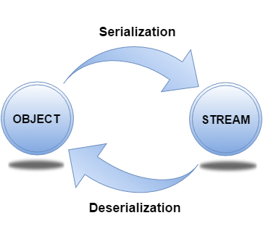
Example: write/read a user-defined class
For serializing the object, we call the writeObject() method ObjectOutputStream, and for deserialization we call the readObject() method of ObjectInputStream class.
Create a class Student: We must have to implement the Serializable interface for serializing the object.
public class Student implements Serializable {
private String ssn;
private String firstName;
private char mi;
private String lastName;
private LocalDate birthDate;
private String street;
private String phone;
private String zipCode;
public Student() {
}
public Student(String ssn, String firstName, char mi, String lastName,
LocalDate birthDate, String street, String phone, String zipCode) {
super();
this.ssn = ssn;
this.firstName = firstName;
this.mi = mi;
this.lastName = lastName;
this.birthDate = birthDate;
this.street = street;
this.phone = phone;
this.zipCode = zipCode;
}
//getter, setter methods

Slide 24
Example: write/read a user-defined class
Create a class StudentService:
public class StudentService {
public boolean write(Student student)
throws FileNotFoundException, IOException {
try (ObjectOutputStream oos = new ObjectOutputStream(
new FileOutputStream("student.txt"))) {
oos.writeObject(student);
}
return true;
}
public Student read() throws FileNotFoundException,
IOException, ClassNotFoundException {
try (ObjectInputStream ois = new ObjectInputStream(
new FileInputStream("student.txt"))) {
Student student = (Student) ois.readObject(); // Upcasting
return student;
}
}

Slide 25
Example: write/read a user-defined class
Create a main function in StudentService:
public static void main(String[] args) {
LocalDate birthDate = LocalDate.of(1999, 1, 1);
Student s1 = new Student("12345", "Nguyen Manh", 'K', "Truong", birthDate,
"Duytan", "0987654321", "084");
StudentService studentServices = new StudentService();
try {
studentServices.write(s1);
System.out.println("Complete write a student to file!");
System.out.println("Reading file:");
System.out.println(studentServices.read());
} catch (IOException e) {
e.printStackTrace();
} catch (ClassNotFoundException e) {
e.printStackTrace();
}
}
}
Output:
Complete write a student to file!
Reading file:
Student [ssn=12345, firstName=Nguyen Manh, mi=K, lastName=Truong, birthDate=1999-01-01,
street=Duytan, phone=0987654321, zipCode=084]

Slide 26
Character stream
Section 3

Slide 27
BufferedWriter Class
BufferedWriter class is used to provide buffering for Writer instances.
It makes the performance fast.
It inherits Writer class.
The buffering characters are used for providing the efficient writing of single arrays, characters, and strings.
Constructor and Methods:
Constructor | Description
BufferedWriter(Writer wrt) | It is used to create a buffered character output stream that uses the default size for an output buffer.
BufferedWriter(Writer wrt, int size) | It is used to create a buffered character output stream that uses the specified size for an output buffer.
void newLine() | It is used to add a new line by writing a line separator.
void write(int c) | It is used to write a single character.
void write(char[] cbuf, int off, int len) | It is used to write a portion of an array of characters.
void write(String s, int off, int len) | It is used to write a portion of a string.
void flush() | It is used to flushes the input stream.
void close() | It is used to closes the input stream

Slide 28

PrintWriter class
Java PrintWriter class is the implementation of Writer class.
It is used to print the formatted representation of objects to the text-output stream.
Class constructor:
PrintWriter(Writer out) → Can append
PrintWriter(Writer out, boolean autoFlush)
PrintWriter(OutputStream out)
PrintWriter(OutputStream out, boolean autoFlush)
PrintWriter(String fileName) → Cannot append.
Notes:
PrintWriter(OutputStream out)Creates a new PrintWriter, without automatic line flushing, from an existing OutputStream.
PrintWriter(OutputStream out, boolean autoFlush)Creates a new PrintWriter from an existing OutputStream.
PrintWriter pw= new PrintWriter( fos ); ví dụ FileOutputStream fos= new FileOutputStream("Example.dat",true); PrintWriter pw= new PrintWriter(fos); true : nếu file chưa tồn tại thì tạo file nếu đã tồn tại thì ghi nối tiếp vào file false: nếu file chưa tồn tại thì tạo file nếu đã tồn tại thì ghi đè lên file cũ Sau khi ghi xong thì nhớ phải đóng pw lại ko thì nó ko thực hiện việc ghi file cho mình pw.close();

Slide 29
PrintWriter class
To open a text file for output: connect a text file to a stream for writing
PrintWriter outputStream = new PrintWriter(new FileOutputStream("out.txt"));
Similar to the long way:
FileOutputStream s = new FileOutputStream("out.txt");
PrintWriter outputStream = new PrintWriter(s);
Goal: create a PrintWriter object:
which uses FileOutputStream to open a text file.
FileOutputStream “connects” PrintWriter to a text file.

Slide 30
Output File Streams
PrintWriter
FileOutputStream
Memory
Disk
smileyOutStream
smiley.txt
PrintWriter smileyOutStream = new PrintWriter( new FileOutputStream(“smiley.txt”) );

Slide 31
Java Tip: Appending to a Text File
To add/append to a file instead of replacing it, use a different constructor for FileOutputStream:
outputStream = new PrintWriter(new FileOutputStream("out.txt", true));
System.out.println("A for append or N for new file:");
char ans = Scanner.next().charAt(0);
boolean append = (ans == 'A' || ans == 'a');
outputStream = new PrintWriter(
new FileOutputStream("out.txt", append));
true if user enters 'A'

Slide 32
Closing a File
An output file should be closed when you are done writing to it.
An input file should be closed when you are done reading from it.
Use the close method of the class PrintWriter, BufferedReader.
outputStream.close();
If a program ends normally it will close any files that are open.

Slide 33

BufferReader class
To open a text file for input: connect a text file to a stream for reading
Goal: a BufferedReader object,
which uses FileReader to open a text file
FileReader “connects” BufferedReader to the text file
For example:
BufferedReader smileyInStream = new BufferedReader
(new FileReader(“smiley.txt"));
Similarly, the long way:
FileReader s = new FileReader(“smiley.txt");
BufferedReader smileyInStream=new BufferedReader(s);
Notes:
Nếu bạn muốn đọc file, đọc lần lượt từng dòng. BufferedReader là sự lựa chọn tốt.

Slide 34
Input File Streams
BufferedReader
FileReader
Memory
Disk
smileyInStream
smiley.txt
BufferedReader smileyInStream = new BufferedReader( new FileReader(“smiley.txt”) );

Slide 35
Summary
I/O Tutorial
Binary Stream
Character stream

Slide 36

Thank you
36

